Slide 1
SESSIE NetWorks
Causal networks of SSSs
(Sequential Enumeration Substitution Systems)

Slide 2
BackGround
Inspired by the creator of Wolfram Alpha, Stephen Wolfram, author of A New Kind of Science.
Shows how simple programs lead to huge complexities
Argues how complexity can arise from extremely simple rules has relevance in other fields
DNA – simple bases create complicated programs.
Our POV → 3-D + Time
String Theory → implies multiple dimensions
Our research has created original mechanisms to evaluate different dimensions.

Slide 3
Simple Rules → Complex Behavior
Strategy:
Take all possible sets of simple rules
Apply them Look for complex behavior
Features similar to the real universe?

Slide 4
BUILDING SESSIES STEP BY STEP
Jade Deschamps
Dr. Caviness
3/16/2017

Slide 5
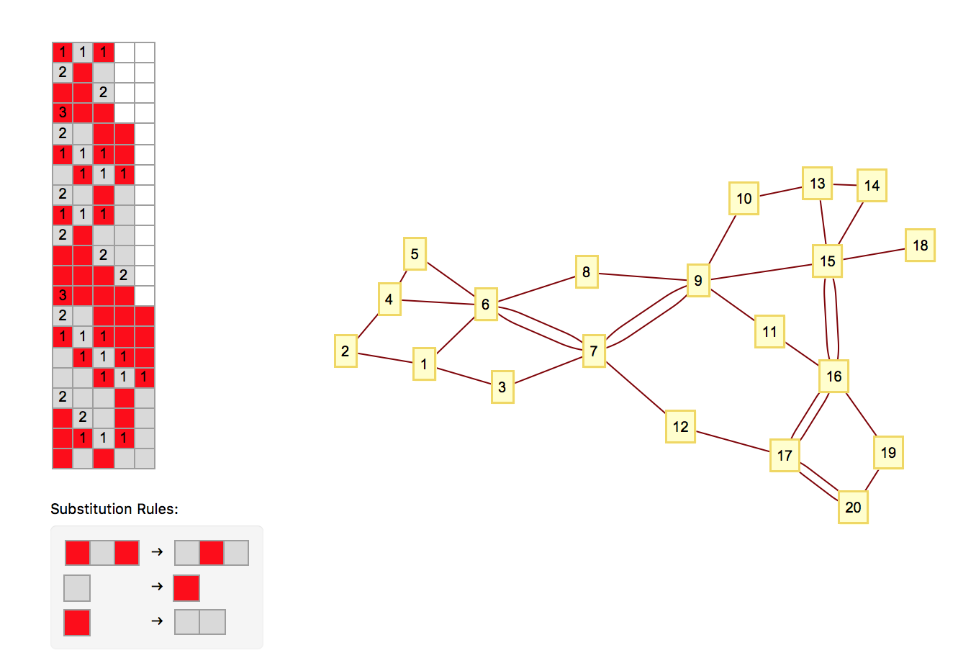
This is a “S.E.S.S.I.E” (Sequential Enumeration Substitution System)
Three Basic Components:
The “Sessie” (the gray and red grid)
The Rulesets
The Nodes (yellow boxes)

Slide 6
The 4 Basic Principles
1. Rules cause Sessies to change.
They destroy old blocks and exchange them for new blocks.
2. We read Sessies from left to right
3. We use only 1 rule per row, and
use the 1st row that works.
4. A Yellow Box means a rule was used.
Gray horizontal lines pair with yellow boxes. (How the boxes connect will be introduced later).
Sessie (aka a grid of cells)
Node 1
Node 2
Node 3
Node 4
And so on
Yellow box 1 w/ Node 1, Box 2 w/ Node 2… and so on.

Slide 7
You can start with any state string. This one is “BAB”. (Red-Gray-red corresponds to B-A-B)
This row matches Rule 1
Rule 1
We only use the first “substitution rule” that works.
Notes:
No rules used: only state string: no nodes

Slide 8
Numbers convey that Rule 1 matched with these cells
rule applications occur “between” rows
1 Rule application → creates 1 node
Exchanging the old row, for this new one below it.
Node 1
Rule 1
Notes:
1 node from 1 rule used

Slide 9
Node 2
Which rule would we use next?
Why are they connected?
Node 2
When new node exchanges the blocks of an old node, a line links the nodes!
Implications:
Let’s say a new node destroyed 3 older blocks, but, these blocks came from 3 different nodes. How many links would the new node have?
Notes:
2 rules used: 2 connected nodes
CONNECTED – 1 cell created by event 1, destroyed by event 2
Identify: what rule was used in row 2? - second rule (see “2” in row 2)
→ Single connection

Slide 10


Node 1
Node 2
Node 3
Rule 2
So, given , what rule would we use for Node 3?
Remember:
Read Sessie L from R
Use the first rule that works
Applying this rule “creates” node 3.
Rule 2
Notes:
2 rules used: 2 connected nodes
CONNECTED – 1 cell created by event 1, destroyed by event 2
Identify: what rule was used in row 2? - second rule (see “2” in row 2)
→ Single connection

Slide 11
Rule 2
If node 1 created a block,
and node 3 replaced that block,
then they must be connected.
T
This is this is the basic premise of building sessies.
Notes:
Identify- nodes 1 and 3 are connected.

Slide 14
3 Links at once!!
See “ 1 1 1”
Let’s go back to our previous implication:
“Let’s say a new node destroyed 2 older blocks, but, these blocks came from two different nodes. How many links would the new node have?”
Notes:
Row 6: 1 1 1 : replaced 3 nodes that were originally formed from 3 different places

Slide 16
Here we have Node 7 connected twice to Node 6. Why might that be?
Simply because Node 7 exchanged two block from Node 6.
Notes:
6 created 2 cells that 7 destroyed: therefore, 2 connections.
Let’s find them on the sessie grid.

